Slide 1

Criteria for choosing a hypervisor
Hardware concerns

Slide 2
There are several considerations:
Compatibility
Performance
Scalability
Hardware virtualization support
Memory & storage requirements
Networking
Power consumption

Slide 3
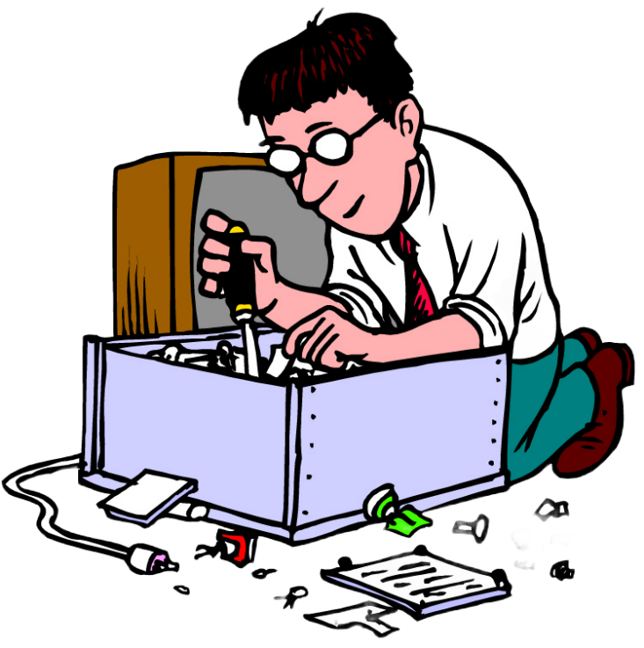
Compatibility
The hypervisor should be compatible with the hardware on which it will be installed.
This includes compatibility with the processor, motherboard, and other hardware components.
For example, some hypervisors may only support certain types of processors, or may require a certain type of motherboard or BIOS.
It is important to ensure that the hardware meets the minimum requirements for the hypervisor to be installed and run effectively.

Slide 4
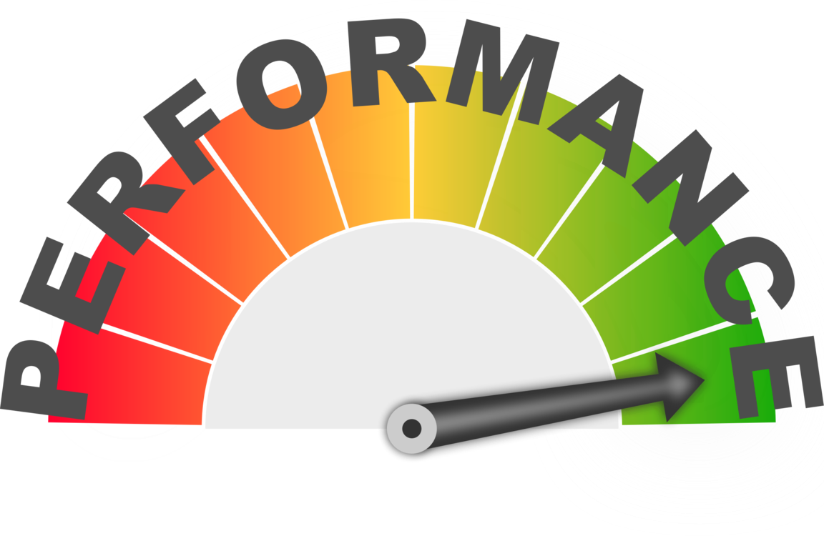
Performance
The hypervisor should be able to utilize the hardware resources efficiently, so that the performance of the virtual machines is not negatively impacted.
This includes the processor, memory, and storage resources.
It is important to ensure that the hardware is sufficient to support the workloads of the virtual machines and that the hypervisor is able to effectively allocate and manage these resources.
The hypervisor should be able to support multiple virtual CPUs and should be able to make use of the processing power of the host system to ensure that the virtual machines have access to sufficient resources.

Slide 5
Scalability
The hypervisor should be able to scale up and down depending on the needs of the organization, and should be able to support the addition of new hardware as needed.
This includes the ability to add more processors, memory, and storage as the workloads of the virtual machines increase.
The hypervisor should also be able to support the addition of new physical hosts as the organization grows, allowing for the creation of a larger, more scalable virtual environment.

Slide 6
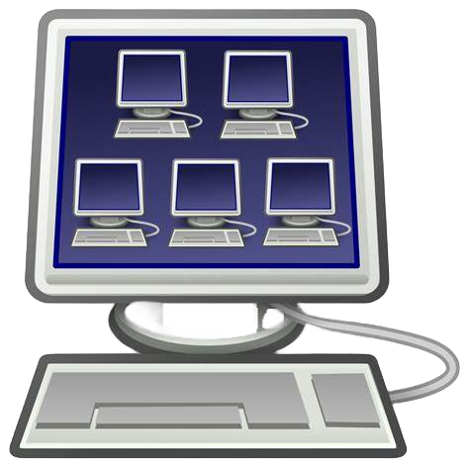
Hardware virtualization
The hardware should support hardware virtualization, which is required for the hypervisor to run effectively.
This includes support for Intel VT or AMD-V, which are the hardware virtualization extensions for Intel and AMD processors, respectively.
Without hardware virtualization support, the hypervisor will not be able to effectively run multiple virtual machines on a single physical host.
Hardware virtualization allows the hypervisor to create virtualized versions of the hardware components of the physical host, including the processor, memory, and I/O devices, and to assign these virtualized resources to the virtual machines as needed.

Slide 7
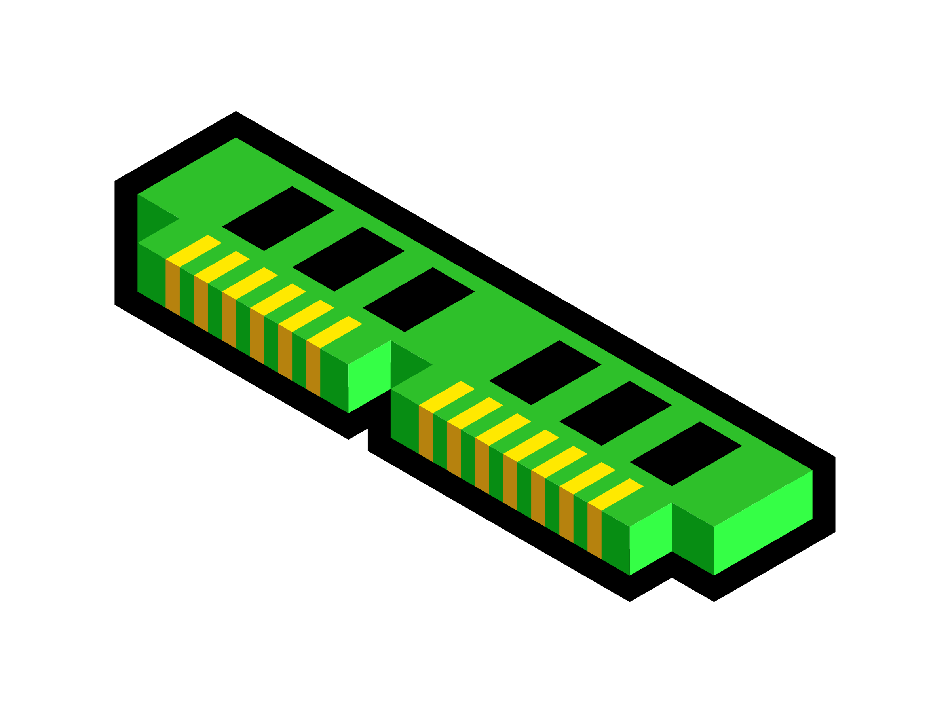
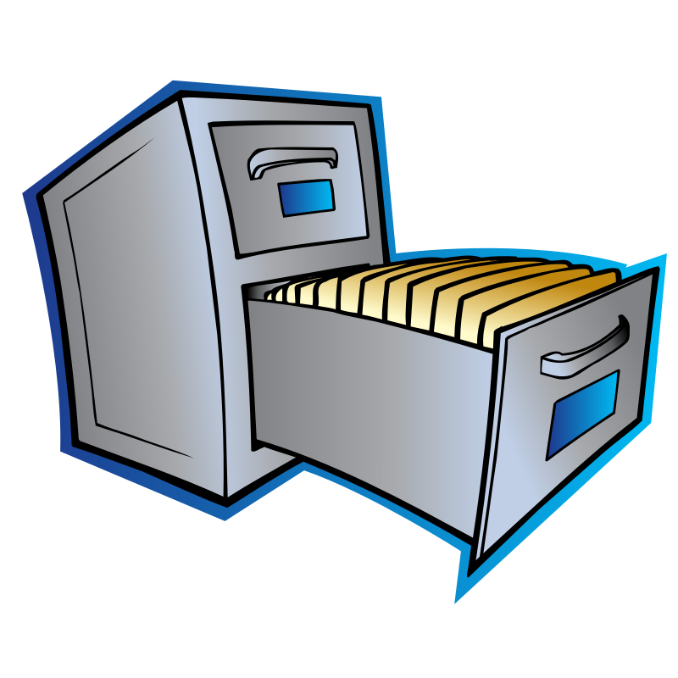
Memory & storage
The hypervisor and the virtual machines it hosts will require sufficient memory and storage to run effectively.
It is important to ensure that there is enough available hardware resources to meet these requirements.
This includes both the physical hardware and any virtual storage devices that are used by the virtual machines.
The hypervisor should be able to support the use of large amounts of memory and storage, and should be able to make efficient use of these resources to ensure that the virtual machines have access to the resources they need.

Slide 8

Networking
The hypervisor should be able to support the networking requirements of the virtual machines, including support for multiple virtual network adapters and VLAN tagging.
This is important for ensuring that the virtual machines can communicate with each other and with external networks as needed.
The hypervisor should be able to support a wide range of networking configurations, including support for various network protocols and the ability to connect to multiple physical networks.

Slide 9
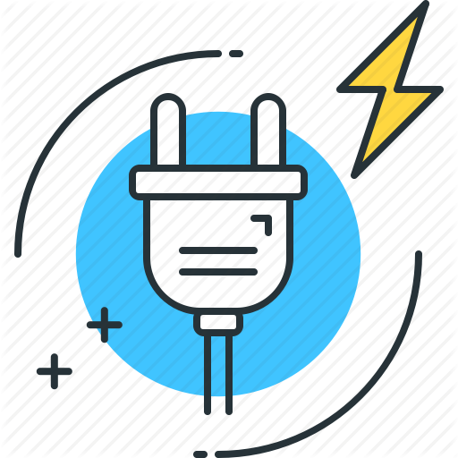
Power Consumption
The hypervisor and the virtual machines it hosts will consume power, so it is important to consider the power requirements of the hardware and ensure that it is sufficient to meet the needs of the organization.
This includes the power usage of the physical host and any additional hardware that may be needed to support the workloads of the virtual machines.
The hypervisor should be able to make efficient use of the power resources of the host system to ensure that the virtual machines have access to sufficient power without causing the host to become overloaded.

